Slide 1
Modals, Dialogs, Popovers & Lightboxes
Computing – Faculty of Business, Law and Digital
martin.reid@solent.ac.uk

Slide 2
“The modal component provides a solid foundation for creating dialogs, popovers and lightboxes."
MATERIALUI.COM., 2020. React Modal component - Material-UI [viewed 23 November 2020].Available from: https://material-ui.com/components/modal/

Slide 3
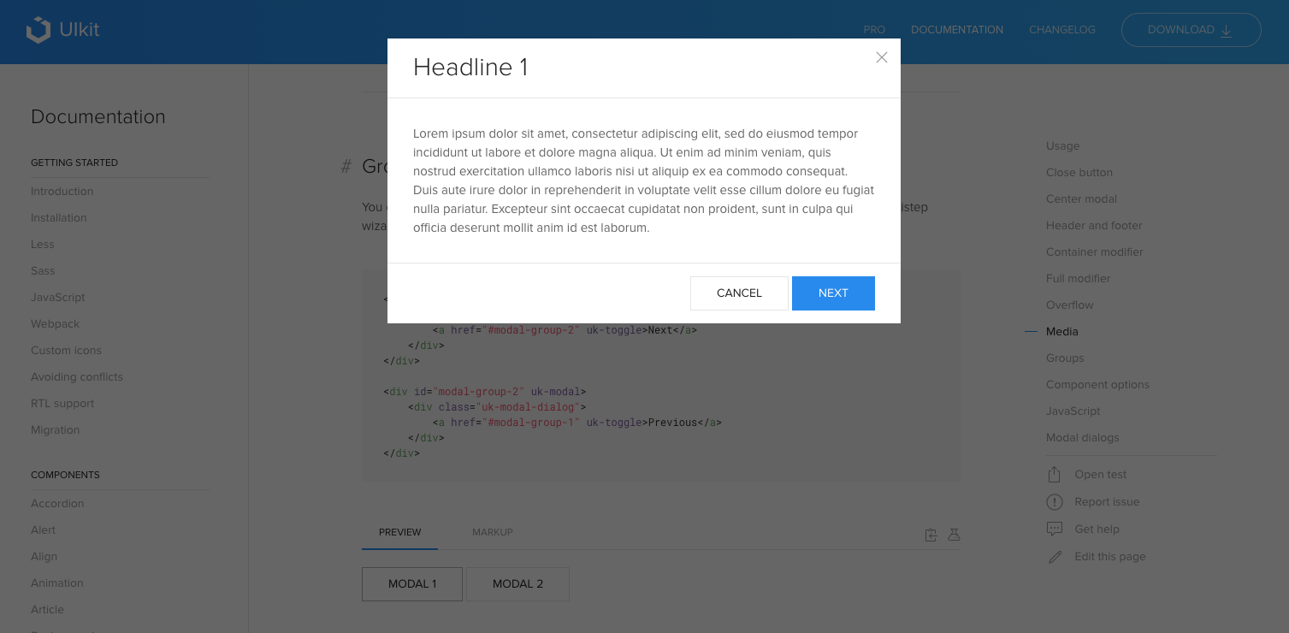
https://getuikit.com/docs/modal

Slide 4
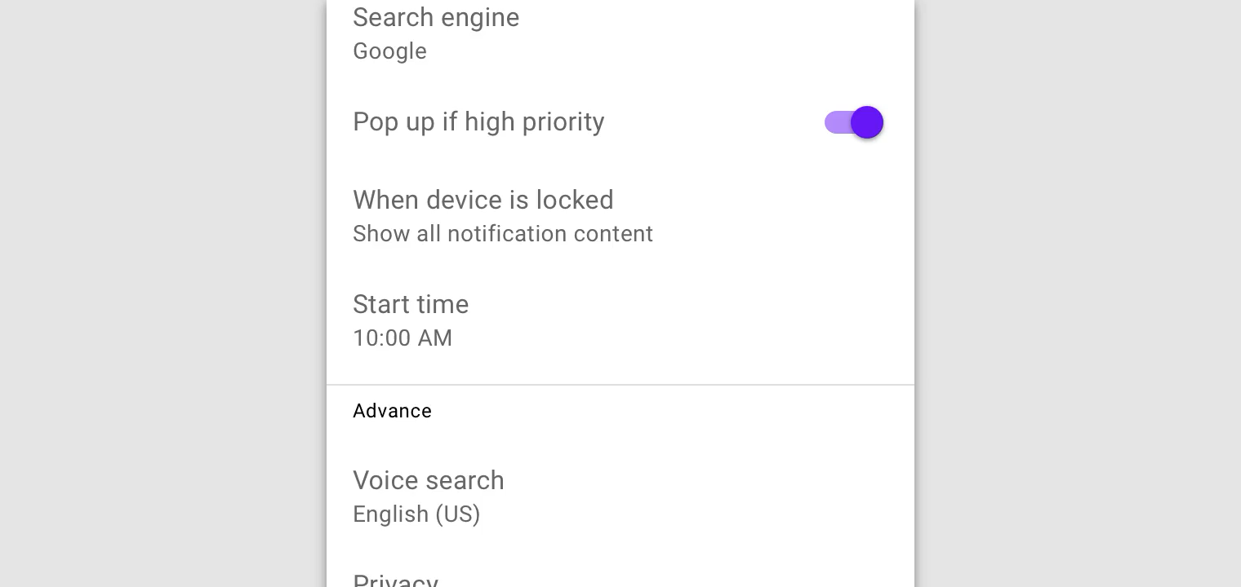

Slide 5
“A Dialog is a type of modal window that appears in front of app content to provide critical information or ask for a decision. Dialogs disable all app functionality when they appear, and remain on screen until confirmed, dismissed, or a required action has been taken.
Dialogs are purposefully interruptive, so they should be used sparingly.
MATERIALUI.COM., 2020. React Modal component - Material-UI [viewed 23 November 2020].Available from: https://material-ui.com/components/modal/

Slide 6
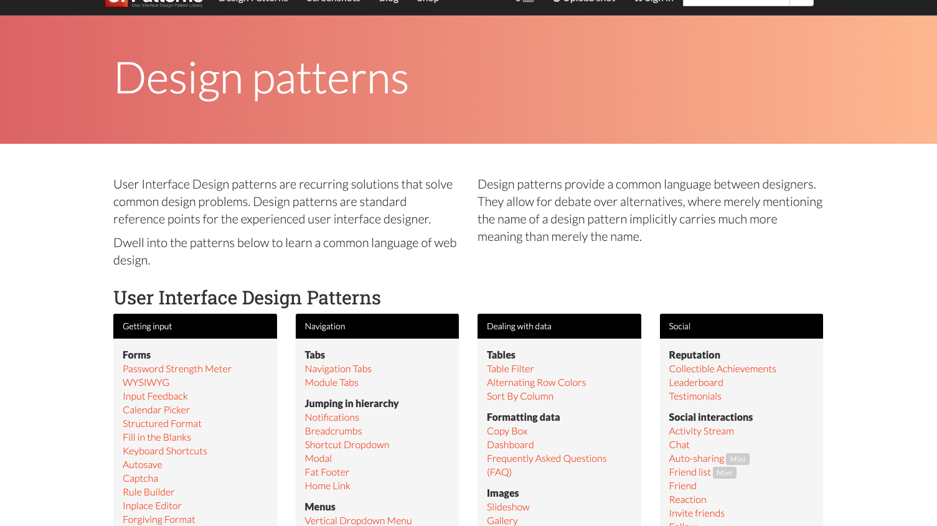
ui-patterns.com, 2020. Modal design pattern [viewed 23 November 2020]. Available from: http://ui-patterns.com/patterns/modal-windows

Slide 7
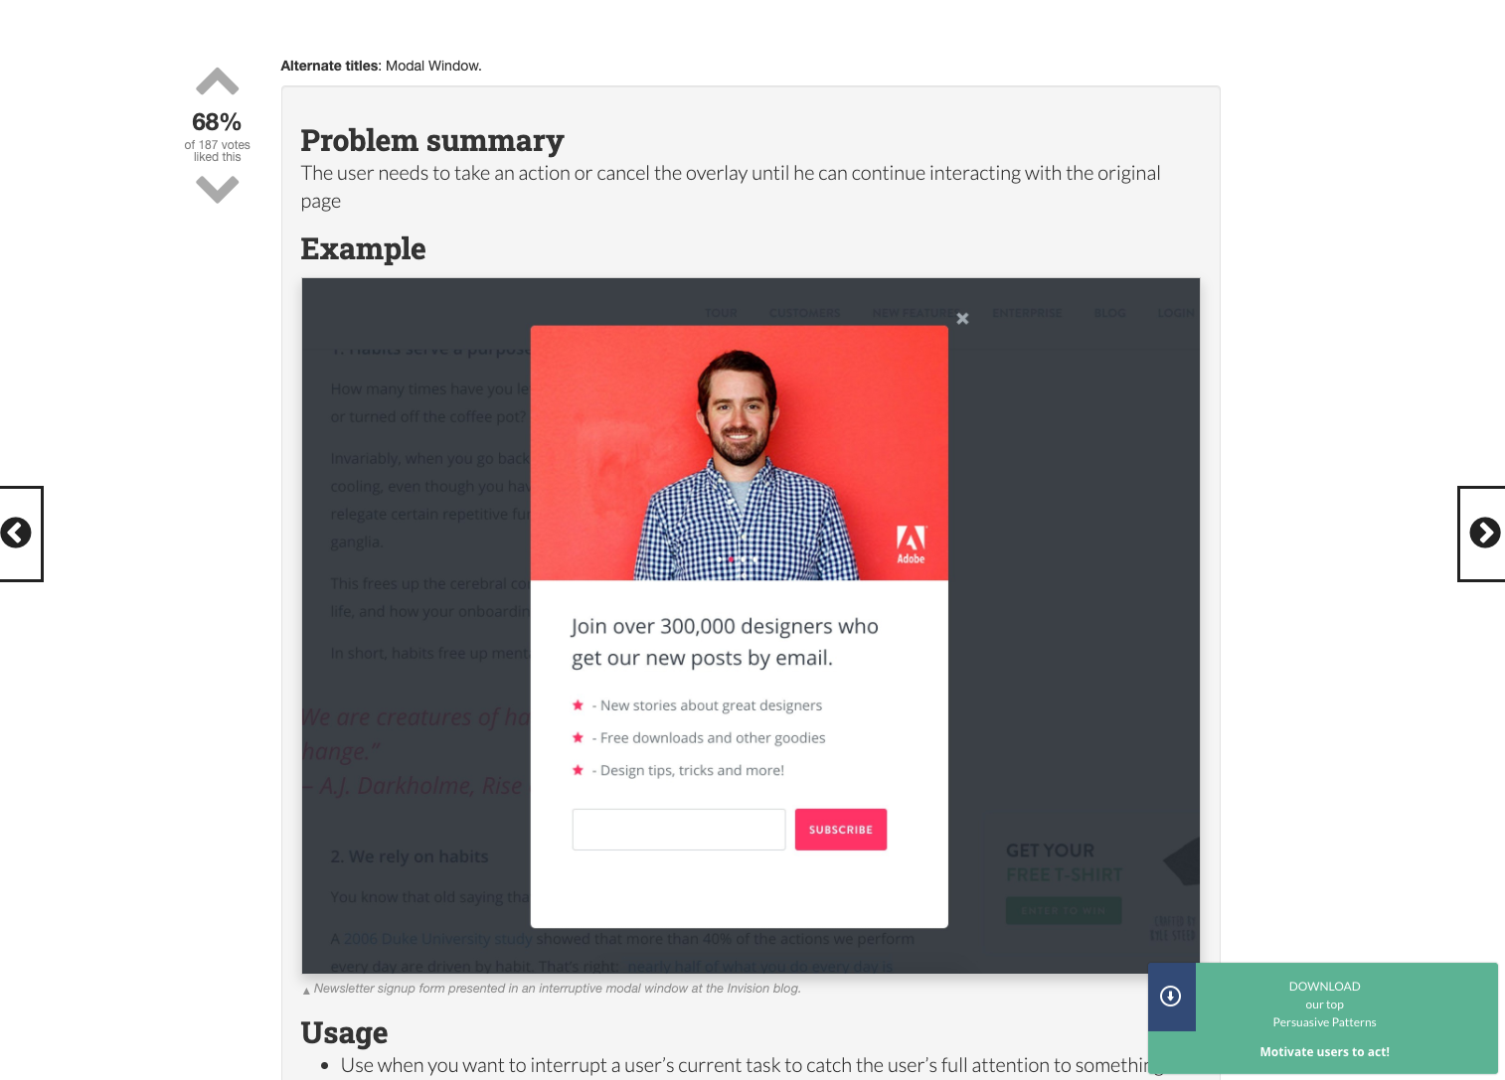
ui-patterns.com, 2020. Modal design pattern [viewed 23 November 2020]. Available from: http://ui-patterns.com/patterns/modal-windows

Slide 8
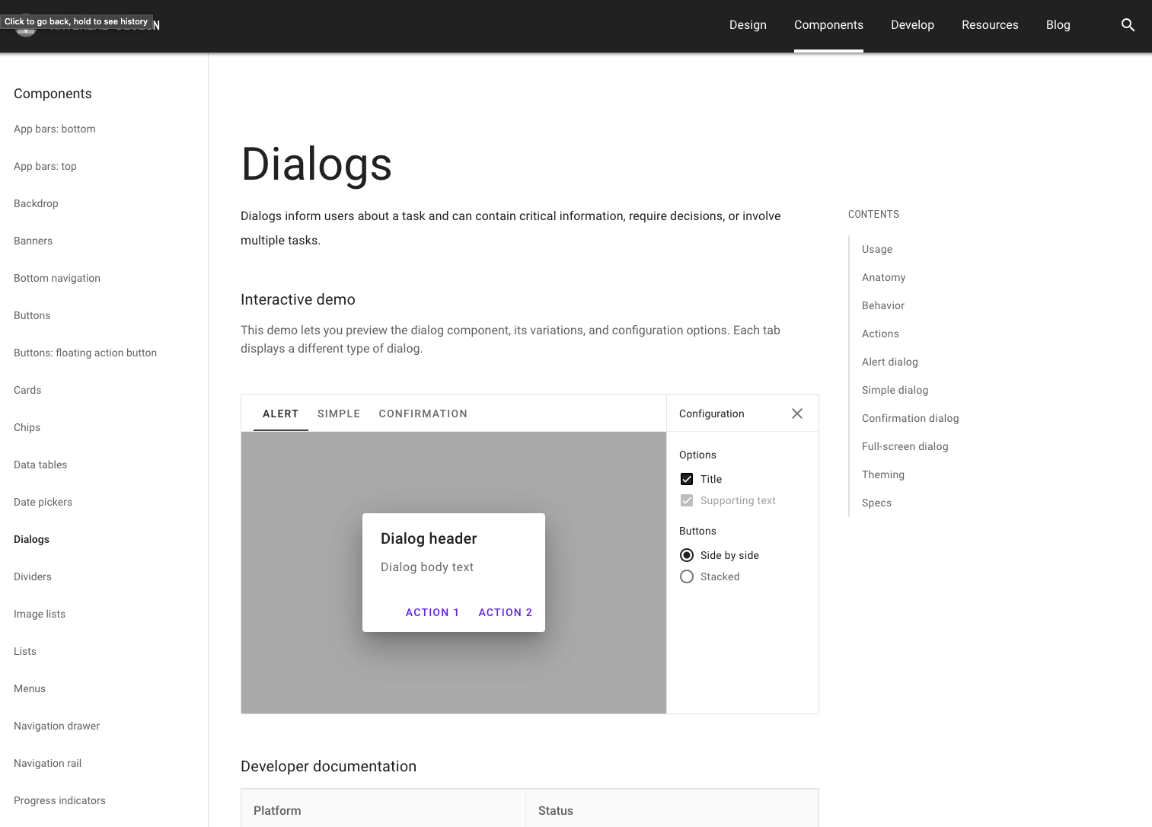
MATERIAL DESIGN, 2020. Material Design [viewed 23 November 2020]. Available from: https://material.io/components/dialogs‌

Slide 9
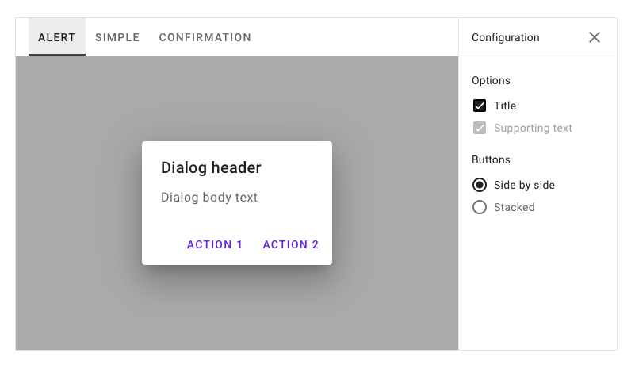
MATERIAL DESIGN, 2020. Material Design [viewed 23 November 2020]. Available from: https://material.io/components/dialogs‌

Slide 10
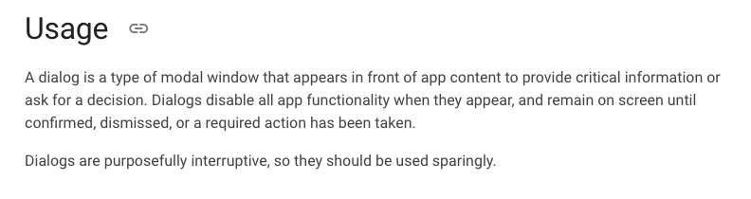
MATERIAL DESIGN, 2020. Material Design [viewed 23 November 2020]. Available from: https://material.io/components/dialogs‌

Slide 11
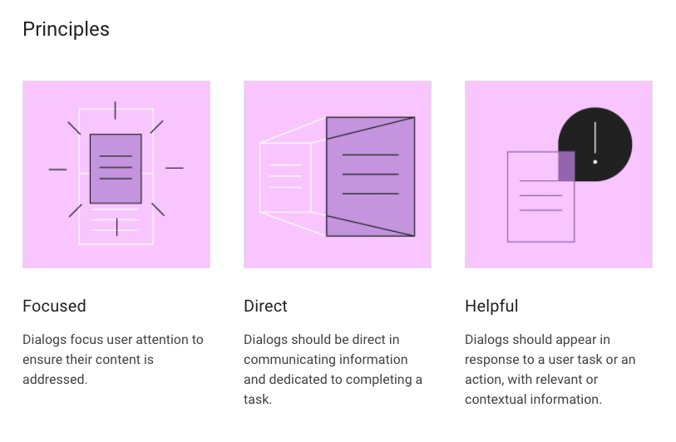
MATERIAL DESIGN, 2020. Material Design [viewed 23 November 2020]. Available from: https://material.io/components/dialogs‌

Slide 12
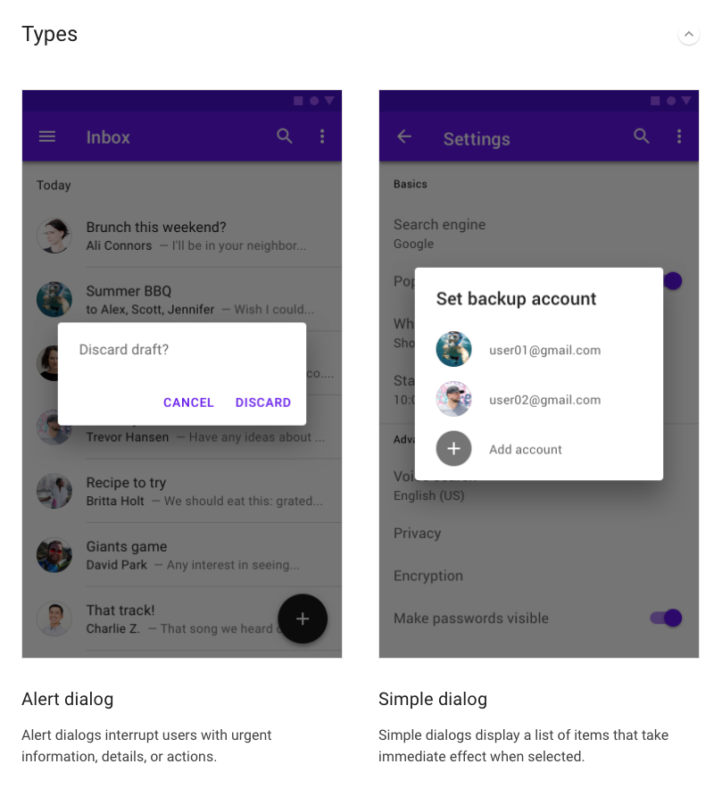
MATERIAL DESIGN, 2020. Material Design [viewed 23 November 2020]. Available from: https://material.io/components/dialogs‌

Slide 13
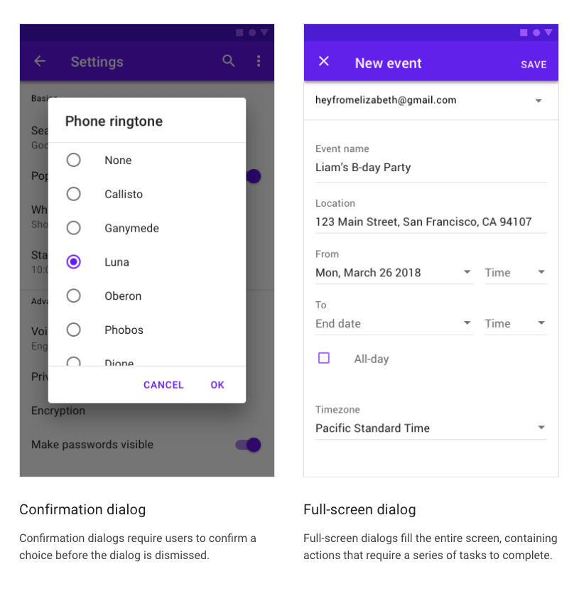
MATERIAL DESIGN, 2020. Material Design [viewed 23 November 2020]. Available from: https://material.io/components/dialogs‌

Slide 14
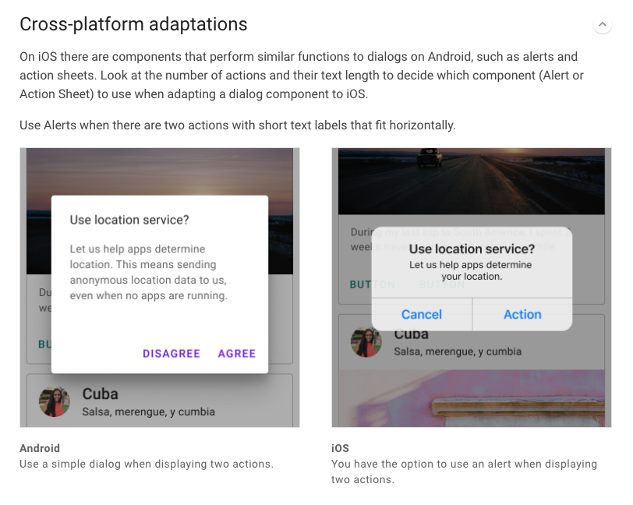
MATERIAL DESIGN, 2020. Material Design [viewed 23 November 2020]. Available from: https://material.io/components/dialogs‌

Slide 15
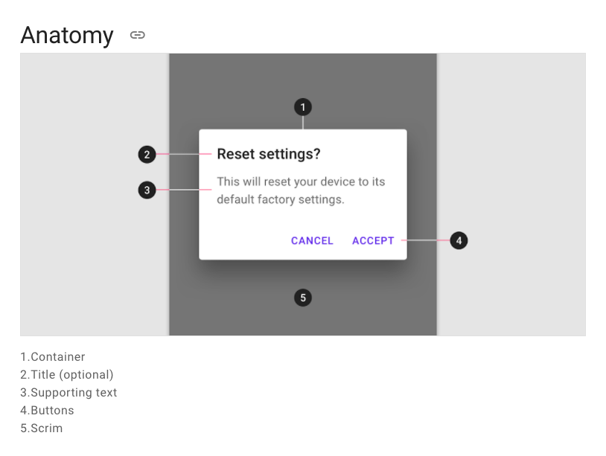
MATERIAL DESIGN, 2020. Material Design [viewed 23 November 2020]. Available from: https://material.io/components/dialogs‌

Slide 16
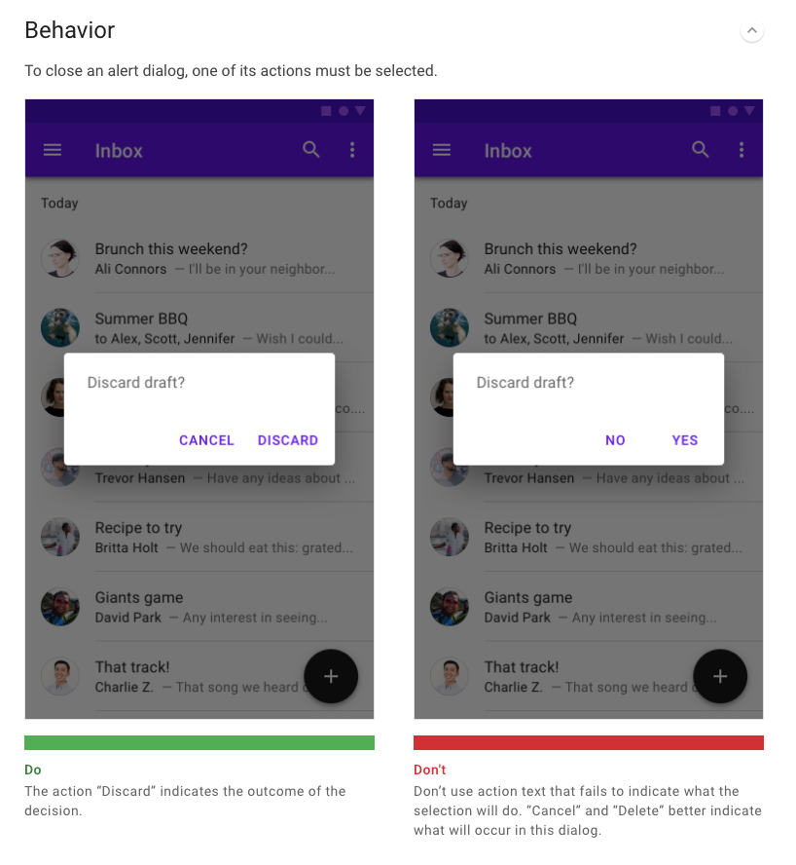
MATERIAL DESIGN, 2020. Material Design [viewed 23 November 2020]. Available from: https://material.io/components/dialogs‌

Slide 17
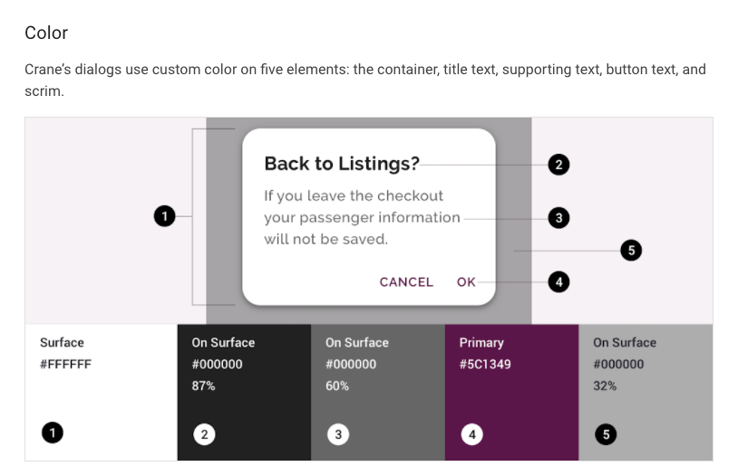
MATERIAL DESIGN, 2020. Material Design [viewed 23 November 2020]. Available from: https://material.io/components/dialogs‌

Slide 18
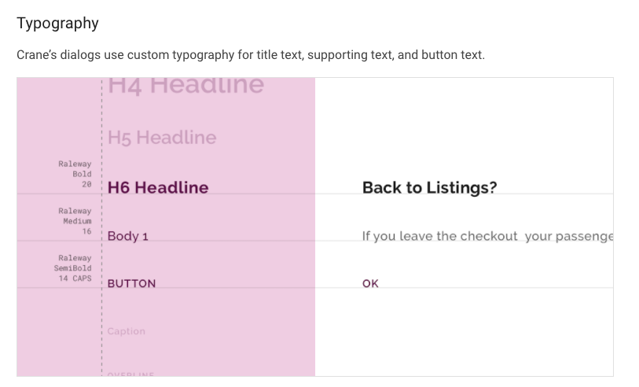
MATERIAL DESIGN, 2020. Material Design [viewed 23 November 2020]. Available from: https://material.io/components/dialogs‌

Slide 19
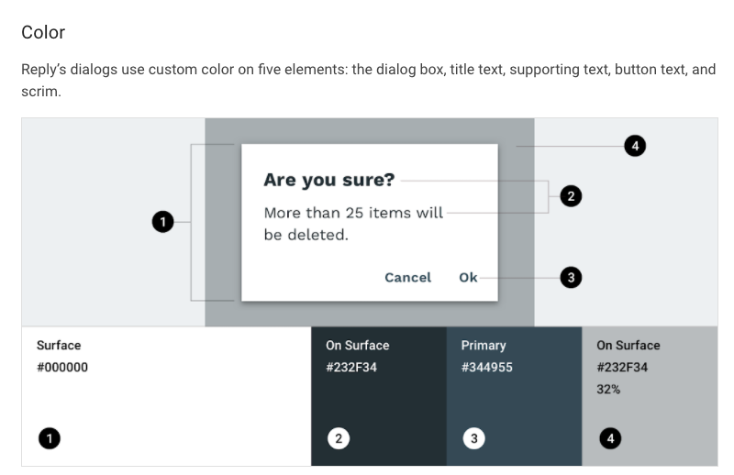
MATERIAL DESIGN, 2020. Material Design [viewed 23 November 2020]. Available from: https://material.io/components/dialogs‌

Slide 20
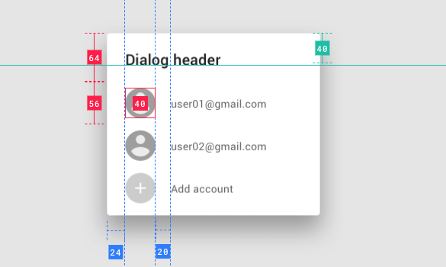
MATERIAL DESIGN, 2020. Material Design [viewed 23 November 2020]. Available from: https://material.io/components/dialogs‌

Slide 21
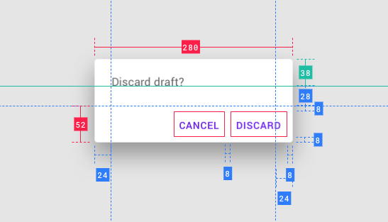
MATERIAL DESIGN, 2020. Material Design [viewed 23 November 2020]. Available from: https://material.io/components/dialogs‌

Slide 22
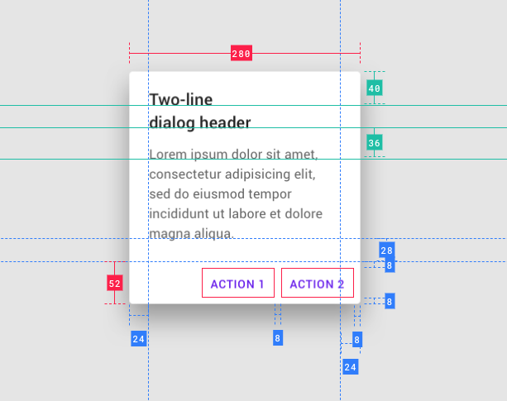
MATERIAL DESIGN, 2020. Material Design [viewed 23 November 2020]. Available from: https://material.io/components/dialogs‌

Slide 23
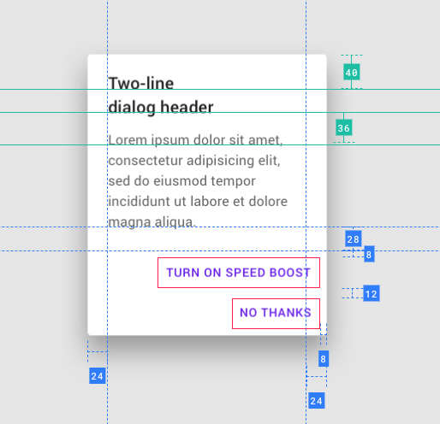
MATERIAL DESIGN, 2020. Material Design [viewed 23 November 2020]. Available from: https://material.io/components/dialogs‌

Slide 24
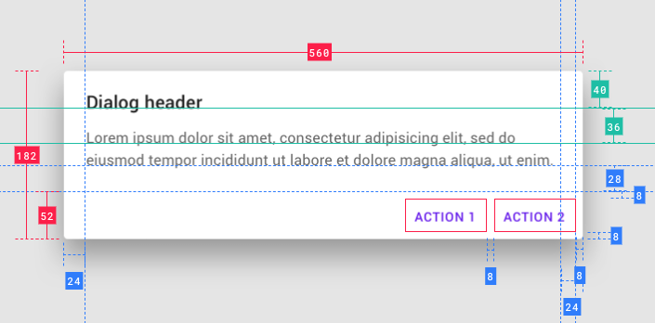
MATERIAL DESIGN, 2020. Material Design [viewed 23 November 2020]. Available from: https://material.io/components/dialogs‌

Slide 25
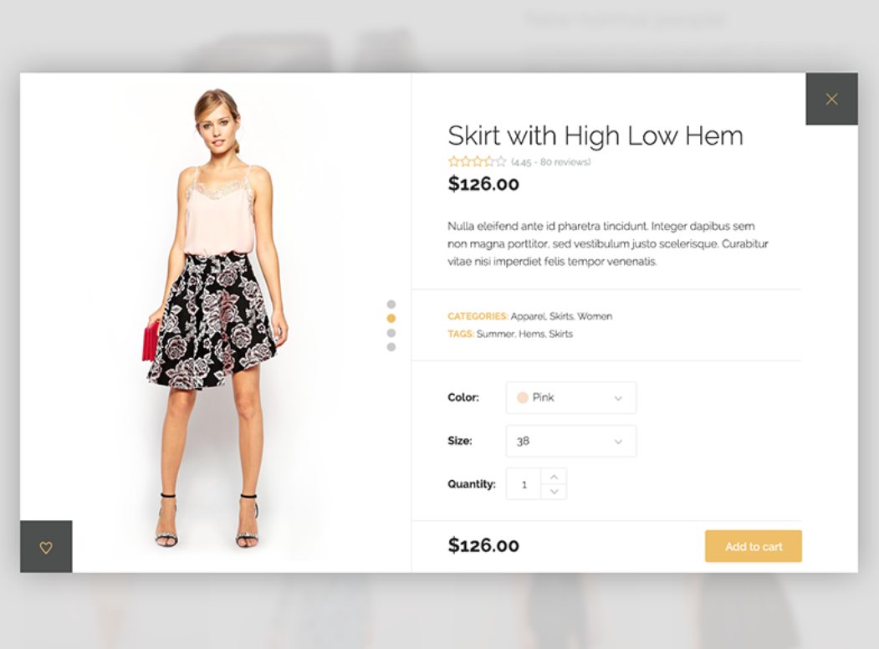
Manuel Masia @pixedelic
MASIA.,M. 2020. Product Quick View [viewed 23 November 2020]. Available from: https://dribbble.com/shots/1817911-Product-Quick-View

Slide 26
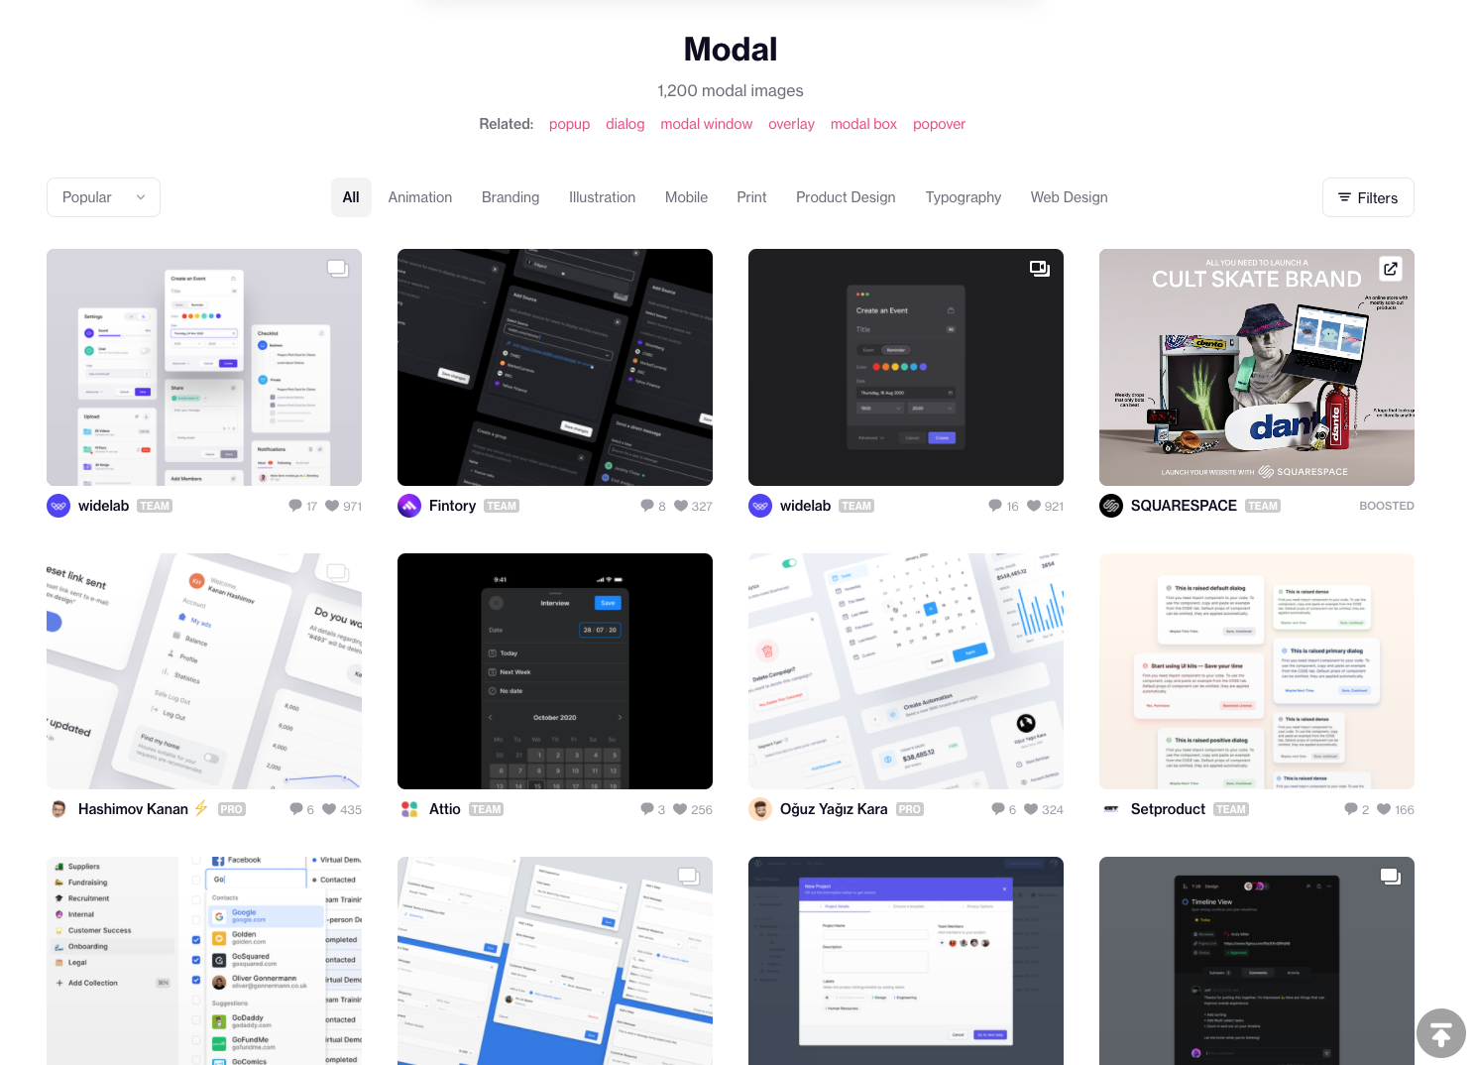
https://dribbble.com/search/modal

Slide 27
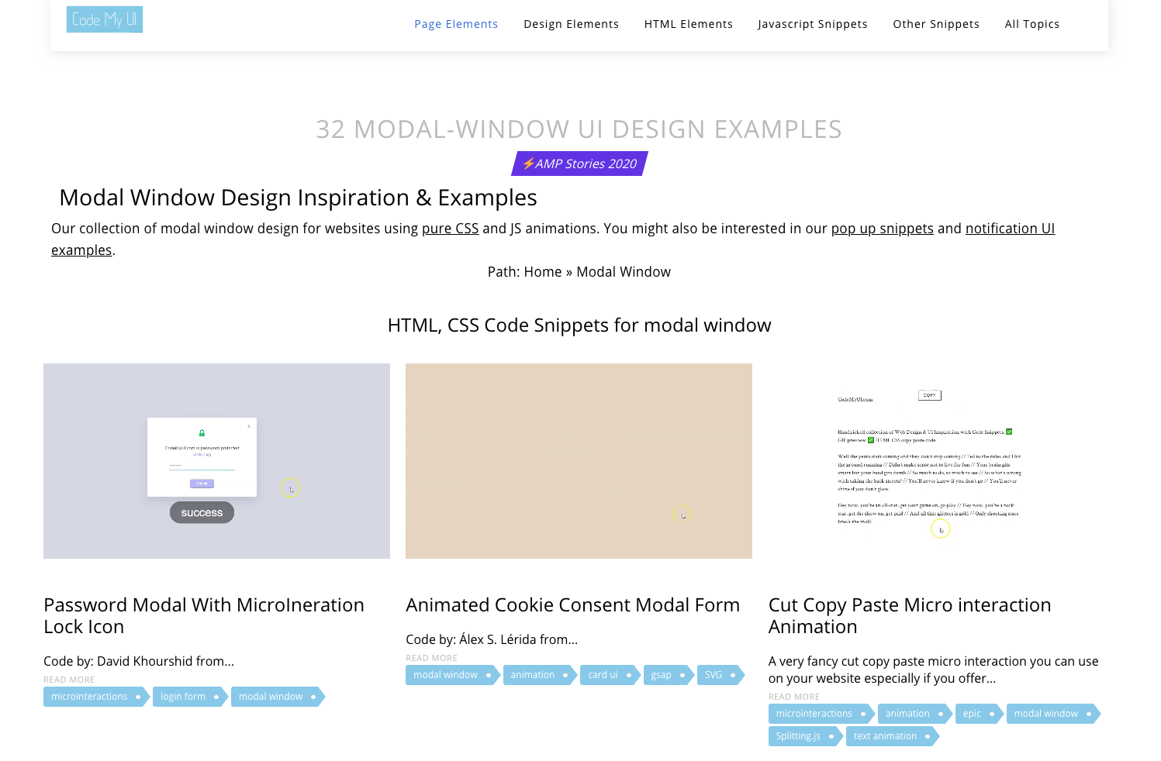
VINCENT, H., 2015. Modal Window Design Inspiration & Examples [viewed 23 November 2020]. Available from: https://codemyui.com/tag/modal-window/

Slide 28
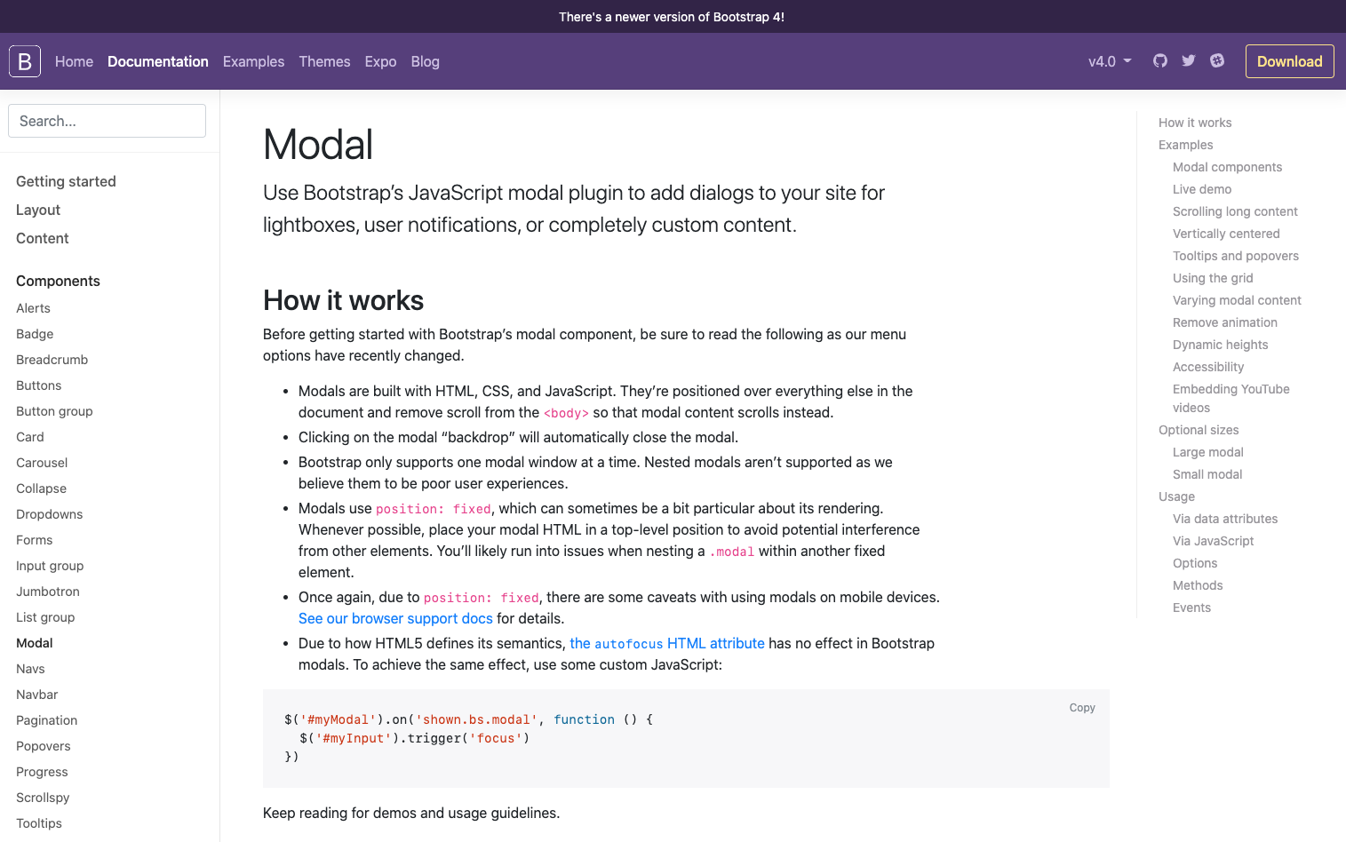
OTTO, M., 2020. Modal [viewed 23 November 2020]. Available from: https://getbootstrap.com/docs/4.0/components/modal/

Slide 29
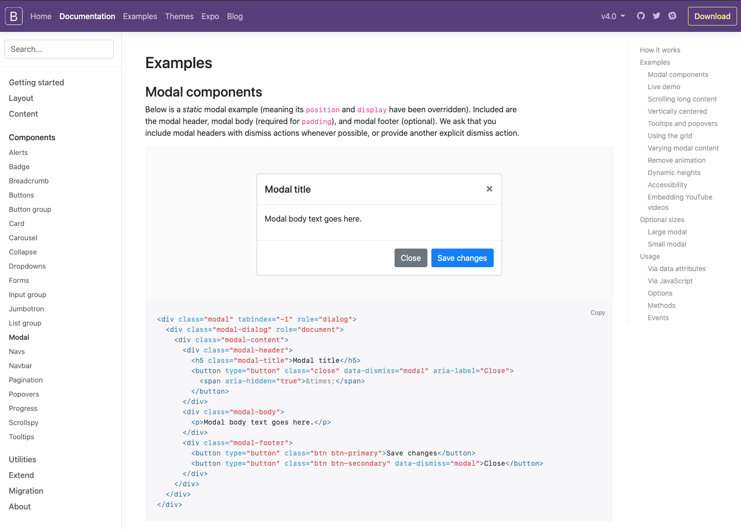
OTTO, M., 2020. Modal [viewed 23 November 2020]. Available from: https://getbootstrap.com/docs/4.0/components/modal/

Slide 30
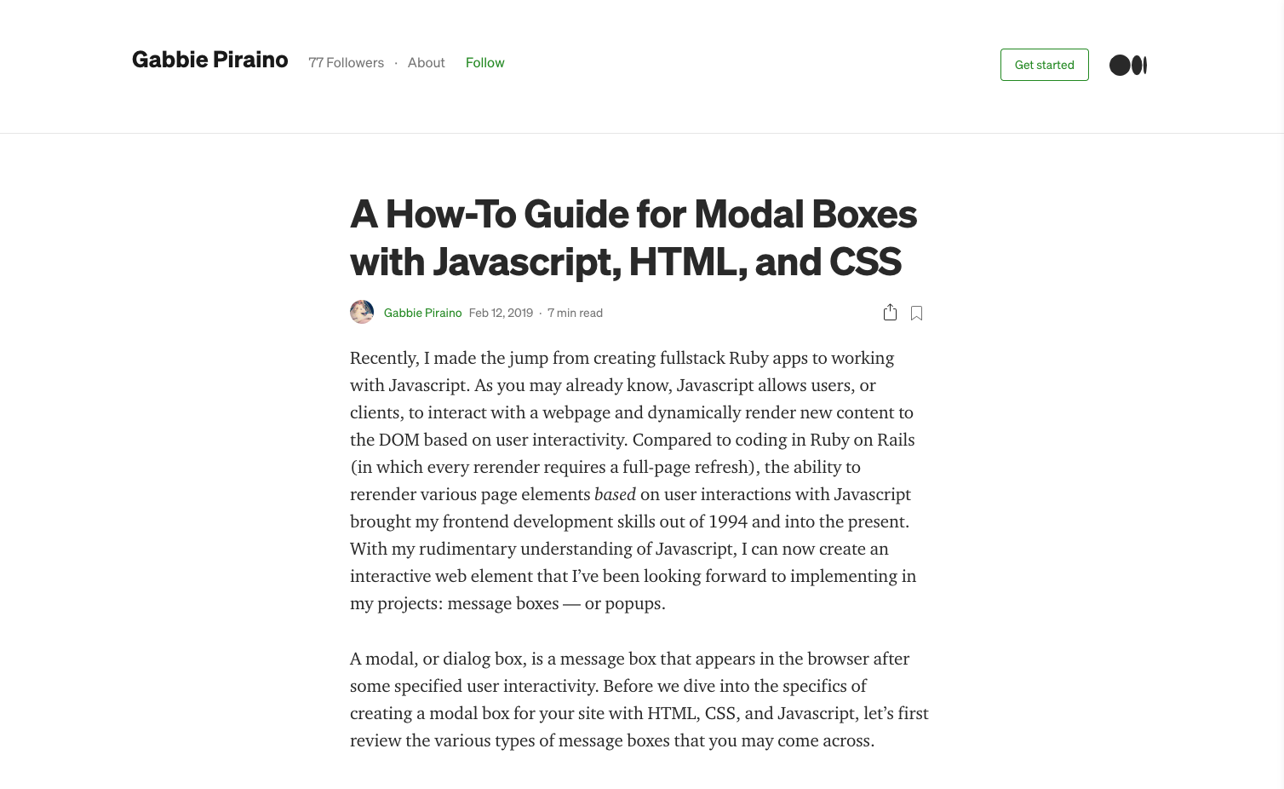
GABBIE PIRAINO, 2019. A How-To Guide for Modal Boxes with Javascript, HTML, and CSS [viewed 23 November 2020]. Available from: https://medium.com/@nerdplusdog/a-how-to-guide-for-modal-boxes-with-javascript-html-and-css-6a49d063987e

Slide 31
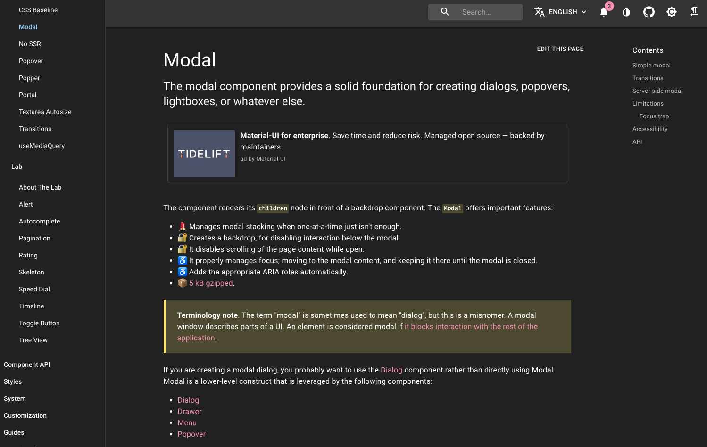
https://material-ui.com/components/modal/

Slide 32
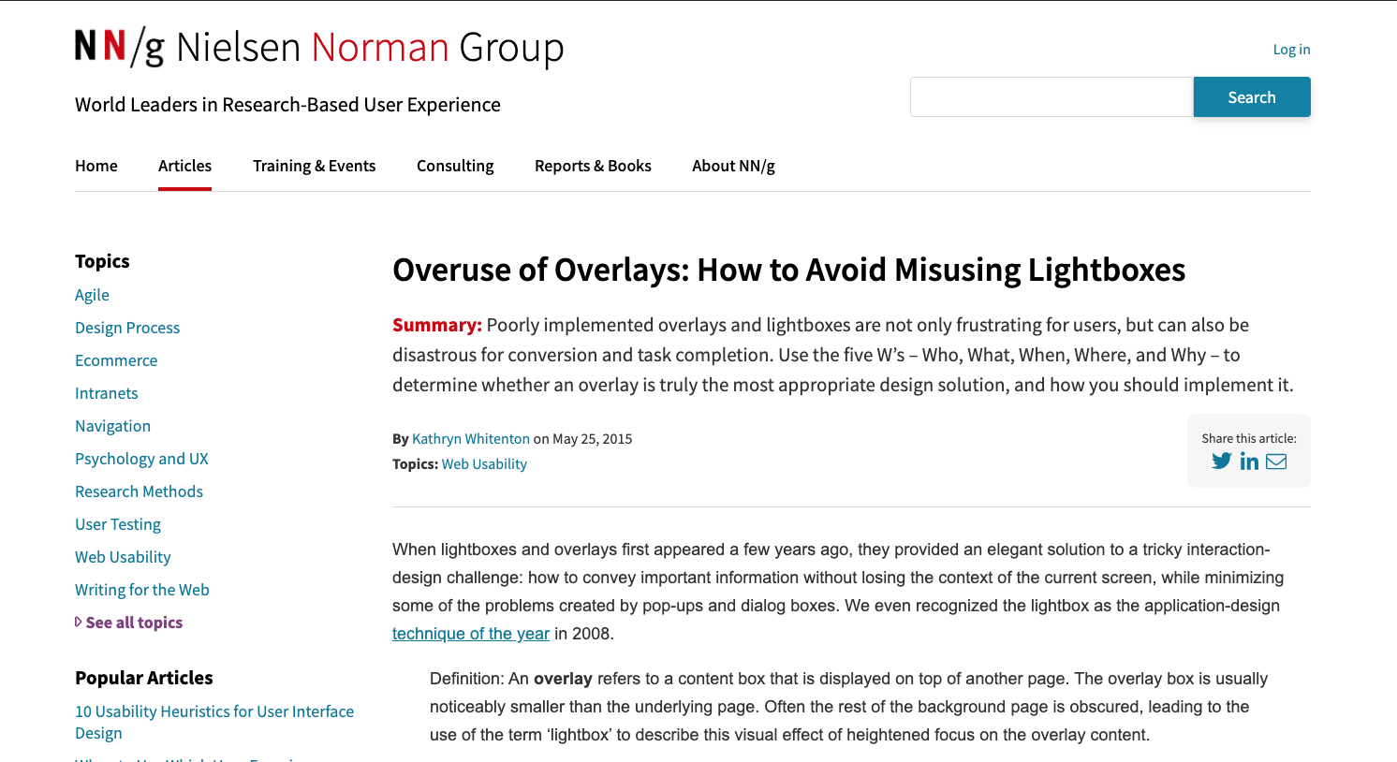
nngroup.com., 2015. Overuse of Overlays: How to Avoid Misusing Lightboxes [viewed 23 November 2020]. Available from: https://www.nngroup.com/articles/overuse-of-overlays/
‌

